Slide 1

IN432
Advanced Web Programming

Slide 2

CSS Box Model
In CSS, the term "box model" is used when talking about design and layout.
The CSS box model is essentially a box that wraps around every HTML element. It consists of: margins, borders, padding, and the actual content.
The image below illustrates the box model:

Slide 3
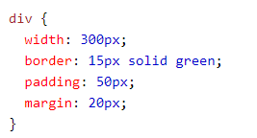
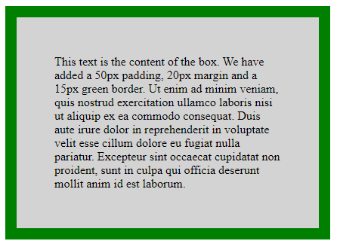
CSS Box Model
Explanation of the different parts:
Content - The content of the box, where text and images appear
Padding - Clears an area around the content. The padding is transparent
Border - A border that goes around the padding and content
Margin - Clears an area outside the border. The margin is transparent

Slide 4
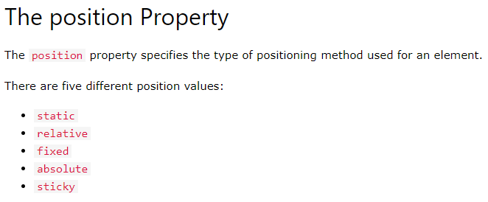
CSS Layout - The position Property

Slide 5

CSS Layout - The position Property
position: static;
HTML elements are positioned static by default.
Static positioned elements are not affected by the top, bottom, left, and right properties.
An element with position: static; is not positioned in any special way; it is always positioned according to the normal flow of the page:

Slide 6
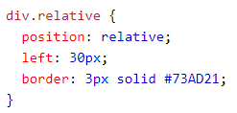
CSS Layout - The position Property
position: relative;
An element with position: relative; is positioned relative to its normal position.
Setting the top, right, bottom, and left properties of a relatively-positioned element will cause it to be adjusted away from its normal position. Other content will not be adjusted to fit into any gap left by the element.

Slide 7
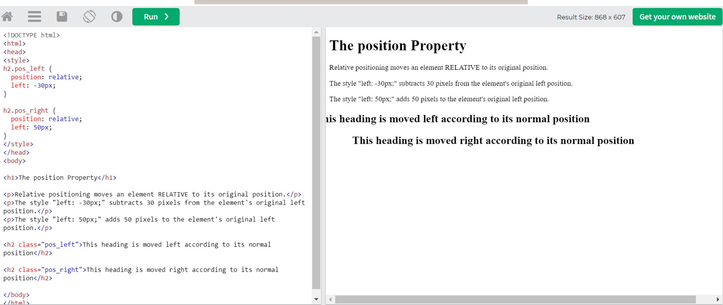

Slide 8
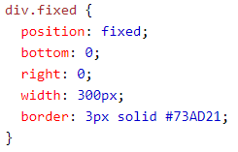
CSS Layout - The position Property
position: fixed;
An element with position: fixed; is positioned relative to the viewport, which means it always stays in the same place even if the page is scrolled. The top, right, bottom, and left properties are used to position the element.
A fixed element does not leave a gap in the page where it would normally have been located.
Here is the CSS that is used:
https://www.w3schools.com/css/tryit.asp?filename=trycss_position_fixed
Notes:
Try to change the values of right, left , top, bottom..
Be careful about width.

Slide 9
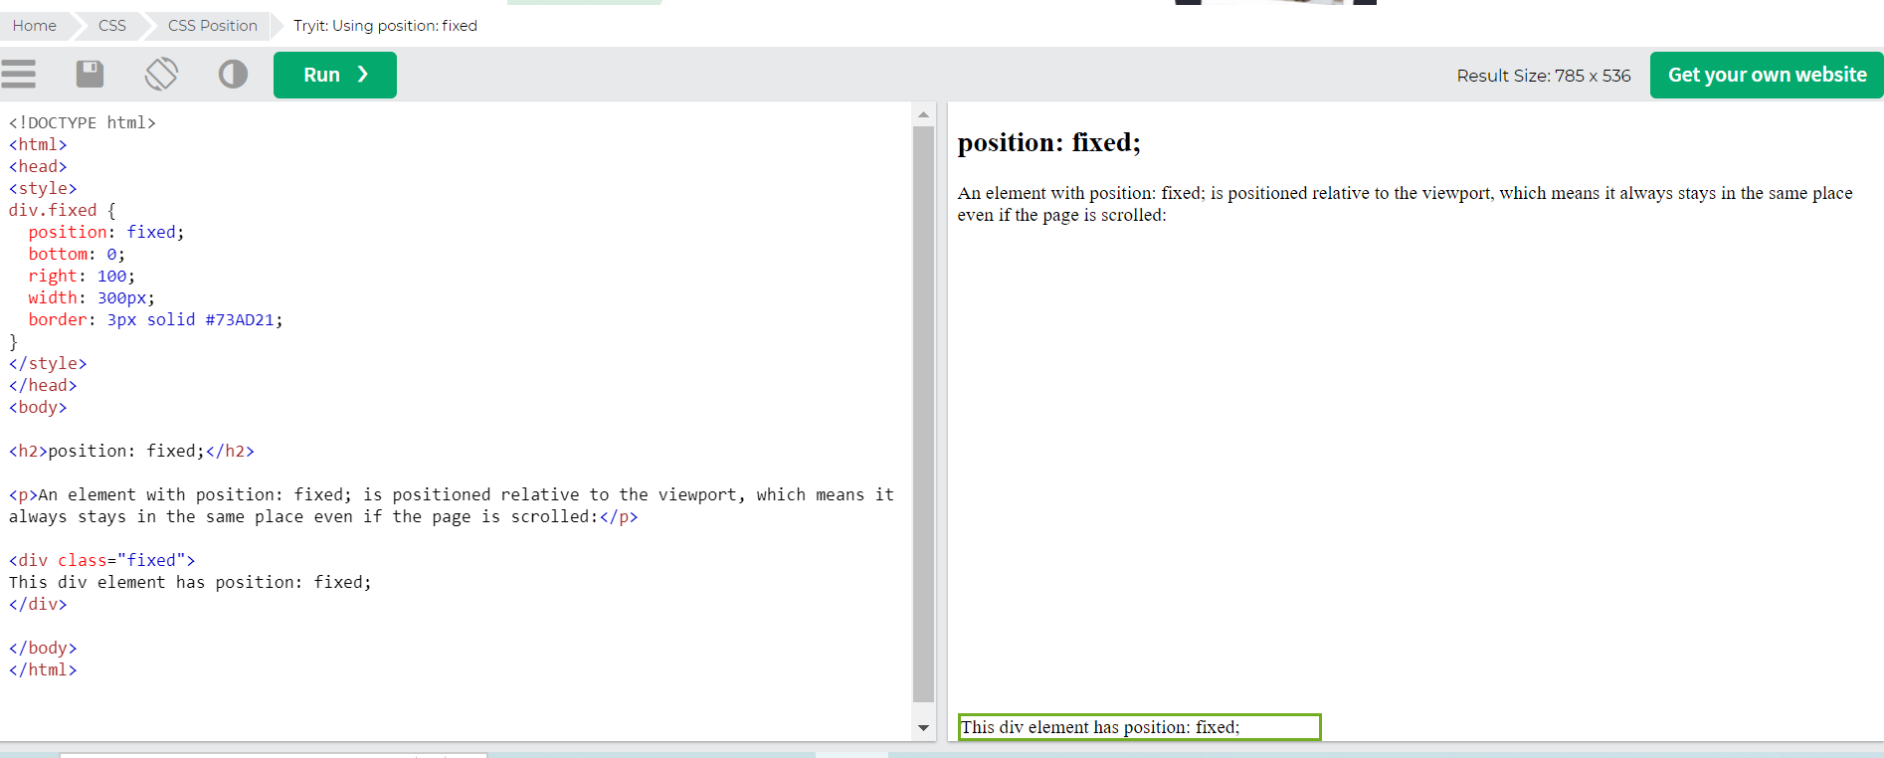

Slide 10
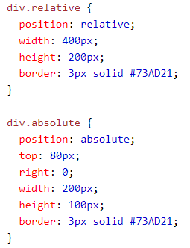
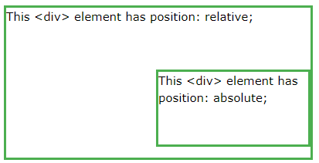
CSS Layout - The position Property
position: absolute;
An element with position: absolute; is positioned relative to the nearest positioned ancestor (instead of positioned relative to the viewport, like fixed).
However; if an absolute positioned element has no positioned ancestors, it uses the document body, and moves along with page scrolling.
Note: A "positioned" element is one whose position is anything except static.
https://www.w3schools.com/cssref/tryit.php?filename=trycss_position_absolute
Notes:
With absolute positioning, an element can be placed anywhere on a page.

Slide 11
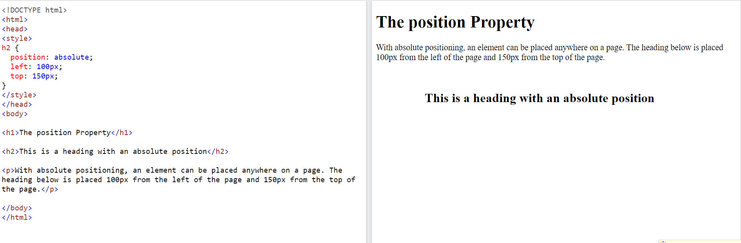

Slide 12
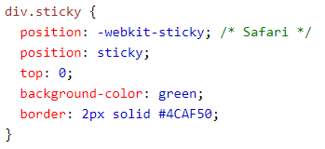
CSS Layout - The position Property
position: sticky;
An element with position: sticky; is positioned based on the user's scroll position.
A sticky element toggles between relative and fixed, depending on the scroll position. It is positioned relative until a given offset position is met in the viewport - then it "sticks" in place (like position:fixed).
https://www.w3schools.com/cssref/tryit.php?filename=trycss_position_sticky

Slide 13
Try by Yourself The difference
https://www.w3schools.com/cssref/tryit.php?filename=trycss_position2

Slide 14
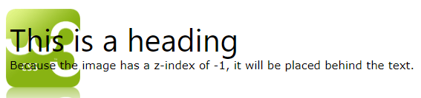
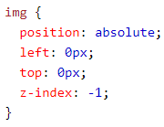
CSS Layout - The position Property
Overlapping Elements
When elements are positioned, they can overlap other elements.
The z-index property specifies the stack order of an element (which element should be placed in front of, or behind, the others).
An element can have a positive or negative stack order:

Slide 15
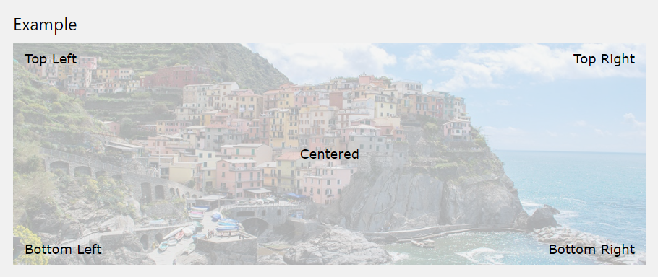
CSS Layout - The position Property
Positioning Text In an Image

Slide 16
CSS Layout - The position Property
Positioning Text In an Image
<style>
.container {
position: relative;
}
.center {
position: absolute;
top: 50%;
width: 100%;
text-align: center;
font-size: 18px;
}
img {
width: 100%;
height: auto;
opacity: 0.3;
}
</style>
<body>
<h2>Image Text</h2>
<p>Center text in image:</p>
<div class="container">
<img src=“mountain.jpg" alt=“Mountain" width="1000" height="300">
<div class="center">Centered</div>
</div>
</body>

Slide 17
Try it By Yourself
https://www.w3schools.com/howto/tryit.asp?filename=tryhow_css_image_text

